Slide 1

The Induction of the Rector
The Methodist Church
of Southern Africa
20th November 2020

Slide 2
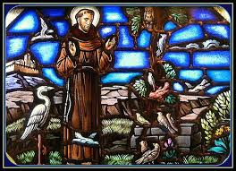
Procession
Please stand as the officiating Ministers, Chaplains, the Chair of Council and the Rector process into the sanctuary.
Hymn
Make Me a Channel
of Your Peace

Slide 3
Make me a channel of your peace
Where there is hatred let me bring your love
Where there is injury, your pardon Lord
And where there's doubt, true faith in you

Slide 4
² Make me a channel of your peace
Where there's despair in life let me bring hope
Where there is darkness, only light
And where there's sadness ever joy

Slide 5
³ Oh, master grant that I may never seek
So much to be consoled as to console
To be understood as to understand
To be loved as to love with all my soul

Slide 6
⁴ Make me a channel of your peace
It isn't pardoning that we are pardoned
In giving to all men let we receive
And in dying that we're born to eternal peace

Slide 7
⁵ Oh, master grant that I may never seek
So much to be consoled as to console
To be understood as to understand
To be loved as to love with all my soul

Slide 8
⁶ Make me a channel of your peace
Where there's despair in life let me bring hope
Where there is darkness, only light
And where there's sadness ever joy

Slide 9
The Superintendent Chaplain: Rev. Daniel Nkomo
Come, let us bow down in worship, let us kneel before the Lord our Maker; for He is our God
All:
We are the people of His pasture, the flock under His care.

Slide 10
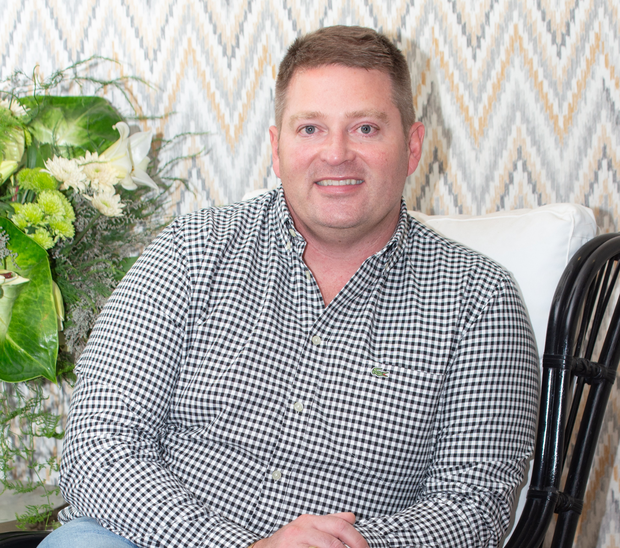
Welcome
Chair of Council
Carel Nolte

Slide 11
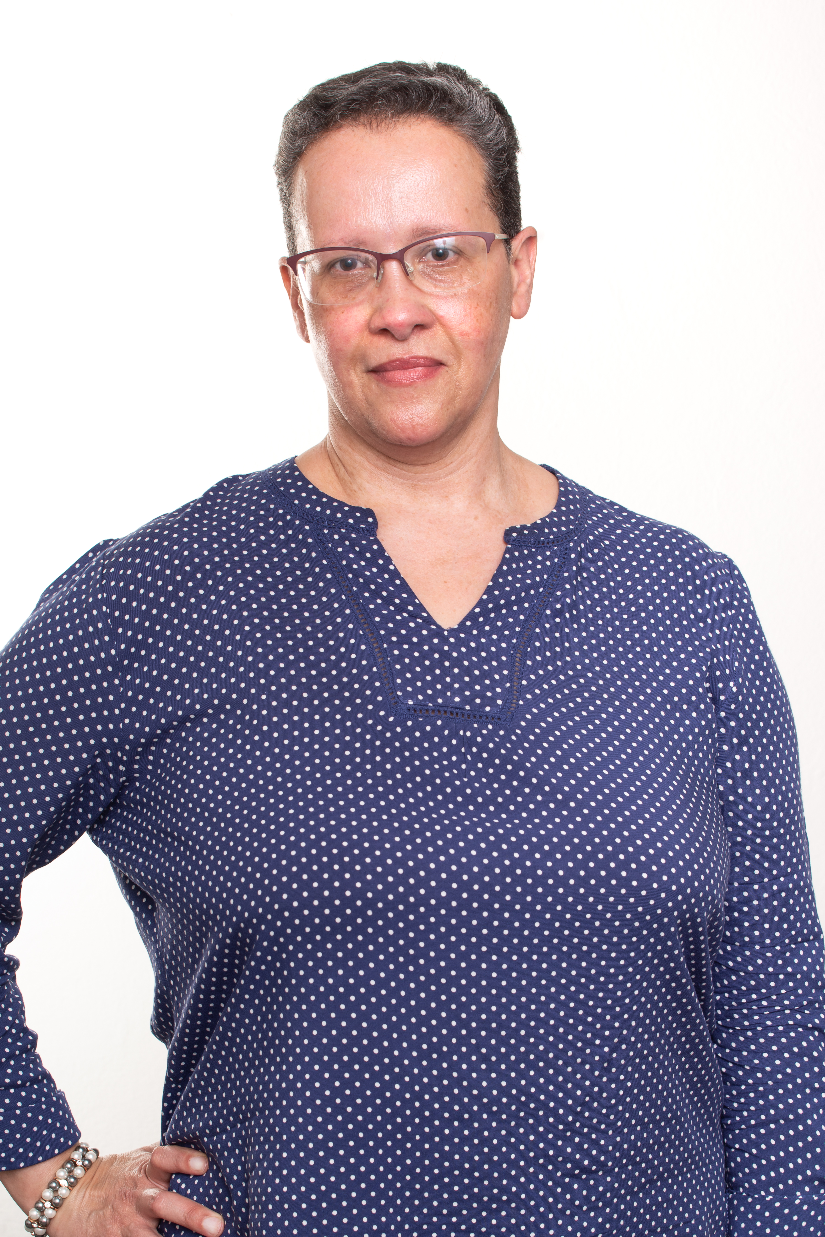
Prayers of Adoration, Praise & Thanksgiving
Rev Faith Whitby,
Bishop of the Central Synod
Followed by
The Lord’s Prayer (said)

Slide 12
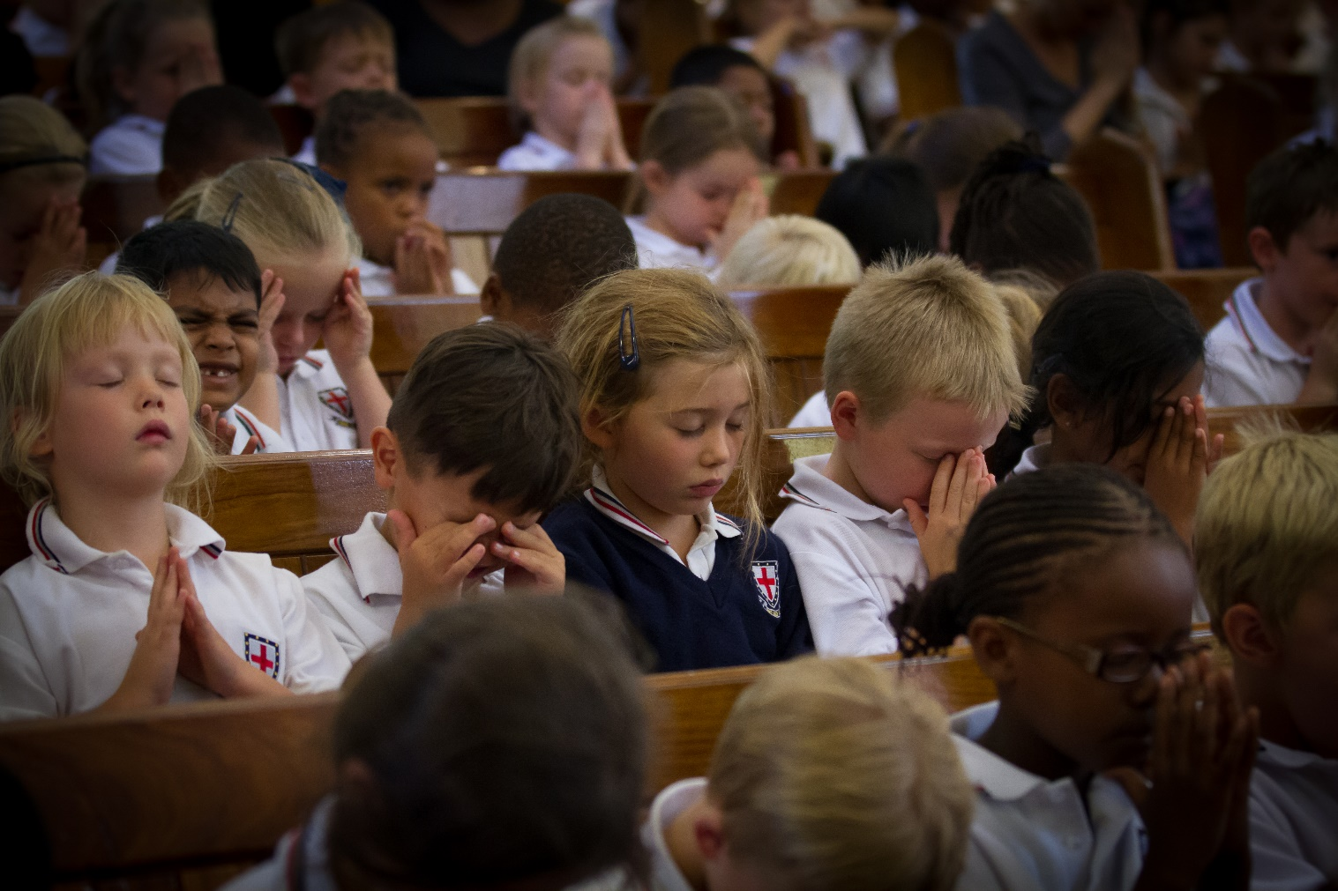
Musical Item – The Junior Preparatory School

Slide 13
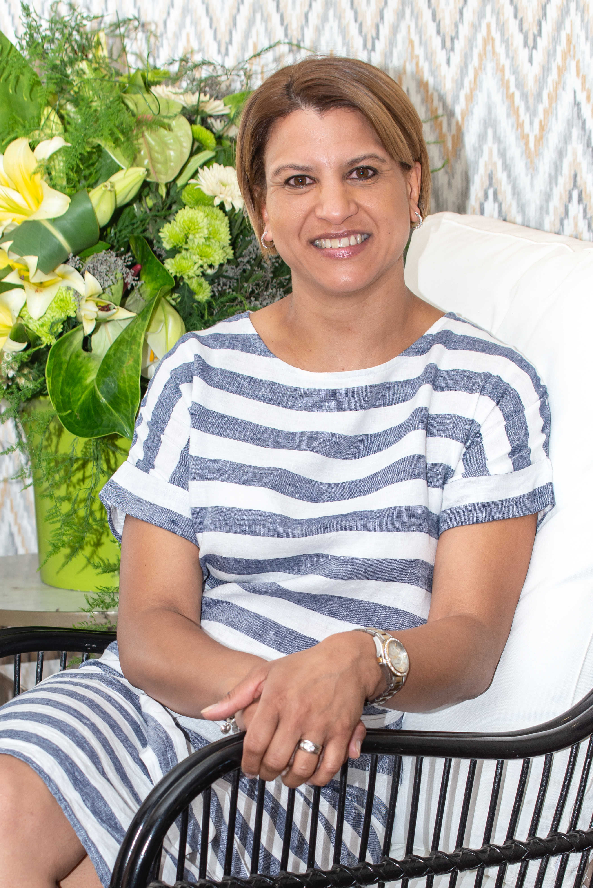
Bible Readings
Deputy Chair of Council:
Megan Rogers
1 Corinthians 13: 4-7
John 15: 12-17

Slide 14
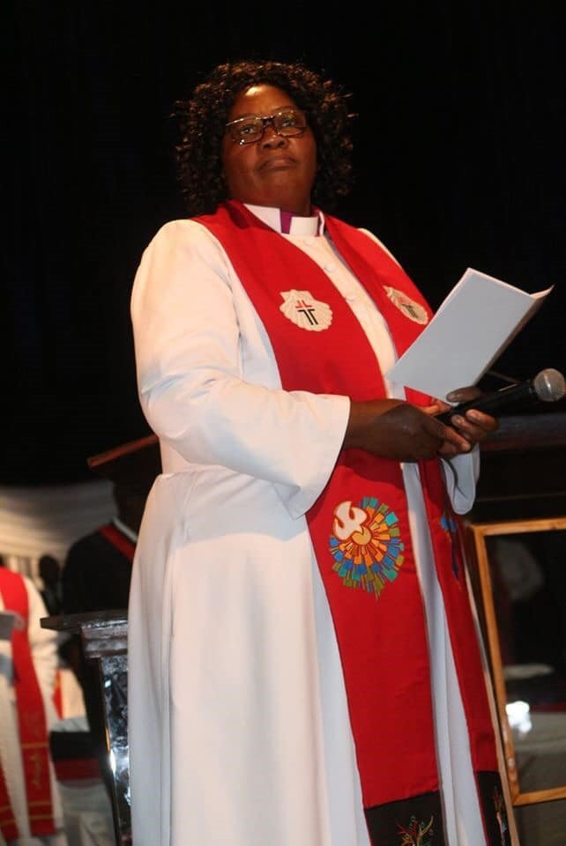
The Charge
Rev N Purity Malinga
Presiding Bishop of
the Methodist Church
of Southern Africa

Slide 15
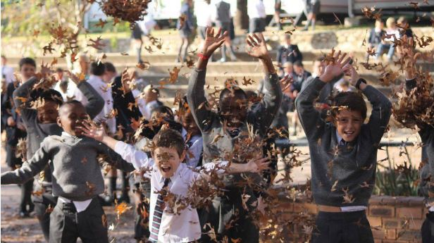
Musical Item – The Boys’ Preparatory School

Slide 16
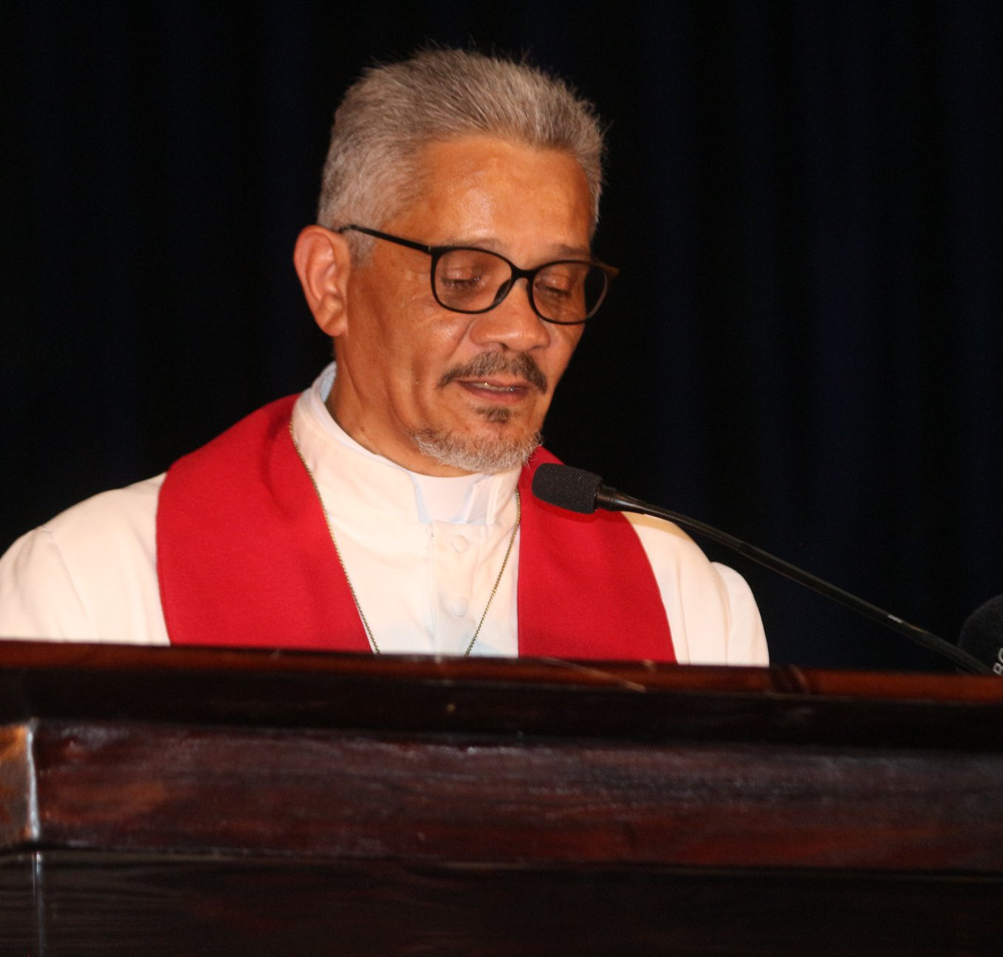
Prayers of Intercession
Rev Michel W Hansrod
General Secretary
of the
Methodist Church of Southern Africa

Slide 17
Induction of the Rector
Chair of Council:
Presiding Bishop Purity, Council members, Staff, Students and members of the St Stithians family, I commend to you Mrs Celeste Gilardi, who has been appointed to serve as Rector of St Stithians College.

Slide 18
The Promises of the Rector
Presiding Bishop: Celeste, through God’s grace you have come to this College.
Do you promise to fulfil the role of Rector to the best of your ability?
Rector: With God’s help, I will.

Slide 19
Presiding Bishop: Will you be faithful in prayer and devotion to God our Saviour?
Will you help the College community to persevere and grow in a life of faith and service?
Will you strive to lead as Christ led, with courage, devotion and humility?
Rector: With God's help, I will.

Slide 20
Presiding Bishop: Celeste, will you strive to advance what is good and right, build positive relationships, and be a custodian of the values of the College?
Rector: With God’s help, I will.

Slide 21
All: Celeste, will you lead us in the way of a servant leader; will you guide and inspire us to be the good citizens God intends us to be?
Rector: I will do so, God being my helper.

Slide 22
Presiding Bishop: Being a Rector is a great responsibility. Let us pray that God will give Celeste the guidance of His Holy Spirit at all times.

Slide 23
Presiding Bishop: Blessed Lord, we believe You have called Celeste to serve this College. Fill her with the gifts and the fruit of Your Holy Spirit.
We pray that the staff, students, Council members and the Saints community will work with Celeste so that this College will continue to make a world of difference in South Africa and beyond. Amen.

Slide 24
Presiding Bishop: Staff, students and the community of St Stithians, I ask you now to receive Celeste who has been appointed to serve you. Will you work with her in honouring God; honouring others & honouring yourselves?
All: Yes we will.

Slide 25
The Rector (with her family) shall kneel, and all the congregation shall stand.
The Presiding Bishop and those assisting shall gather around and bless the Rector saying:
In the name of the Lord Jesus Christ, and by the authority of the Methodist Church of Southern Africa, I induct you as the Rector of St Stithians College.

Slide 26
Bishop: Lord, bless Celeste. Pour Your Holy Spirit upon her that she may fulfil her duties with wisdom, courage and faithfulness to You, through Jesus Christ our Lord. Amen
ALL: The Lord bless you and keep you; the Lord make His face to shine upon you and be gracious unto you; the Lord look on you with kindness and give you peace. Amen

Slide 27
The Presiding Bishop and those assisting, extend the right hand of welcome to the Rector
The Signs of Office
The Presiding Bishop hands Celeste the Bible.
The Chaplain hands Celeste the candle.

Slide 28
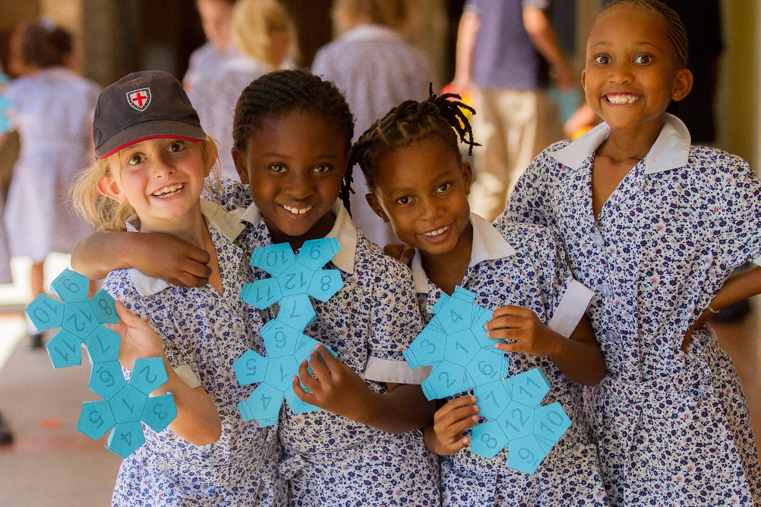
Musical Item – The Girls’ Preparatory School

Slide 29
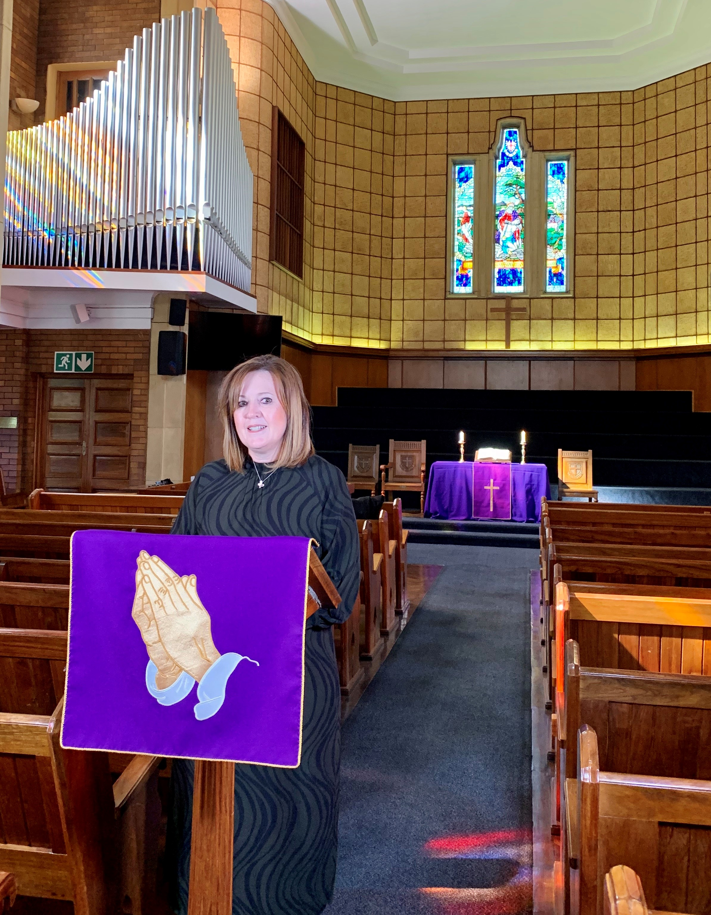
The Rector Responds

Slide 30
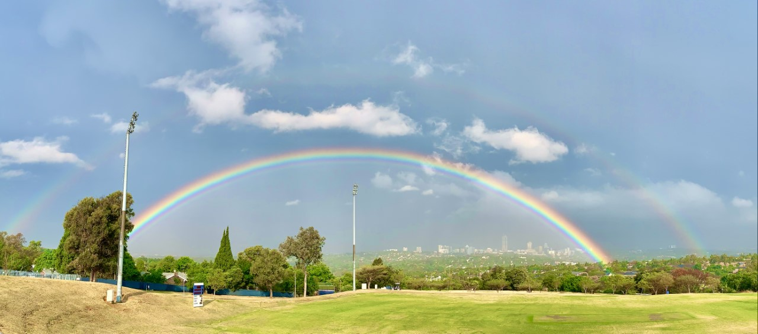
Invitation to Refreshments

Slide 31
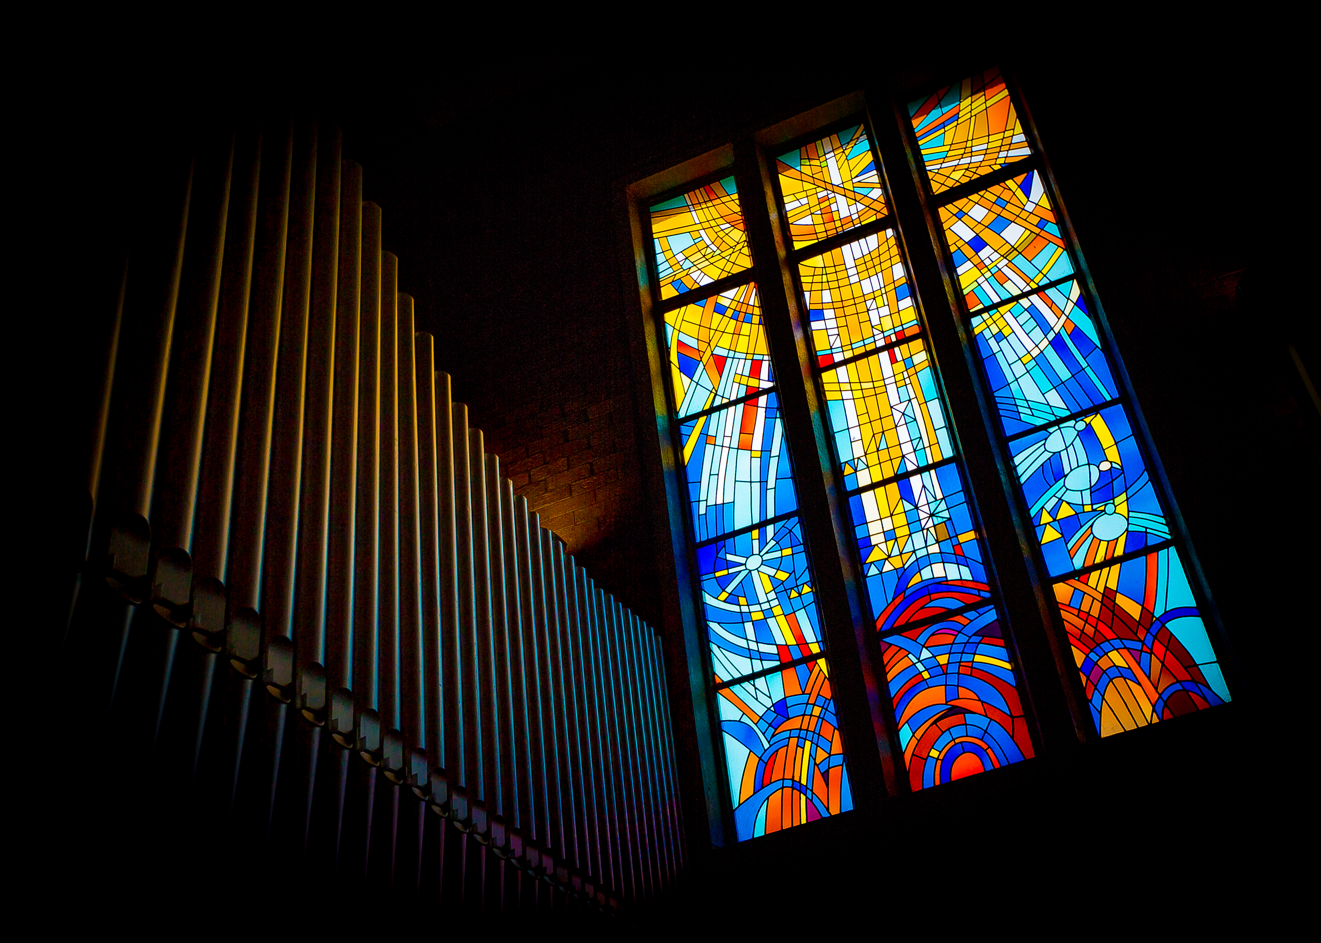
The Benediction The Presiding Bishop

Slide 32
Hymn and Procession
The College Hymn
¹ Be thou my vision, O Lord of my heart,
be all else but naught to me, save that thou art;
be thou my best thought in the day and the night, both waking and sleeping, thy presence my light.

Slide 33
² Be thou my wisdom, be thou my true word,
be thou ever with me, and I with thee Lord;
be thou my great Father, and I thy true son;
be thou in me dwelling, and I with thee one.

Slide 34
³ Be thou my breastplate, my sword for the fight;
be thou my whole armour, be thou my true might;
be thou my soul's shelter, be thou my strong tower:
O raise thou me heavenward, great Power of my power.

Slide 35
⁴ Riches I heed not, nor man's empty praise:
be thou mine inheritance now and always;
be thou and thou only the first in my heart;
O Sovereign of heaven, my treasure thou art.

Slide 36
⁵ High King of heaven, thou heaven's bright sun,
O grant me its joys after victory is won;
great Heart of my own heart, whatever befall,
still be thou my vision, O Ruler of all.

