Slide 1
TOLERANCE
Artist: Guy Ferrer

Slide 2
GUY FERRER: Guy Ferrer (born in 1955), is a contemporary painter and sculptor of French/ Mediterranean origin, who is impassioned by the spiritualties of the world.
2007: T.O.L.E.R.A.N.C.E – Ferrer created this impressive sculptural work in response to major religious tensions (like those of 9-11 in 2001). He intends to highlight the intolerance of terrorism around the world.
There are 6/7 series of TOLERANCE, widely exhibited in France, Germany, USA, Poland, the United Arab Emirates and more recently, South Africa. Each sculpture, mounted on a plinth, stands about 4 metres tall.

Slide 3
Please note:
This is an opinion on the artwork and may not necessarily reflect the thoughts and interpretations of the artist himself.

Slide 4
T.O.L.E.R.A.N.C.E
A message of COMPASSION, HOPE and mutual RESPECT
Encourages an ACCEPTANCE of one another
Together we can create HARMONY
Many religious organisations have been associated with violence over centuries
TOLERANCE should be universal

Slide 5
LETTERS in a word are part of a whole
A word becomes meaningful because of ALL its letters
“Meet” each letter and respect its significance in a word
Don’t look at their differences but rather as a whole, uniting together for WORLD PEACE
In the same way different cultures and spiritual beliefs in a society can live harmoniously together – showing respect, kindness and acceptance of each other

Slide 6
We all can choose “Our GOD”
We need to respect that “Our GOD” may not be the same GOD of another culture or religious sector
We should not judge others by who their religion, heritage or culture.
Each letter in the word TOLERANCE could suggest a religious belief or a sense of belonging
Remember this is an opinion only

Slide 7
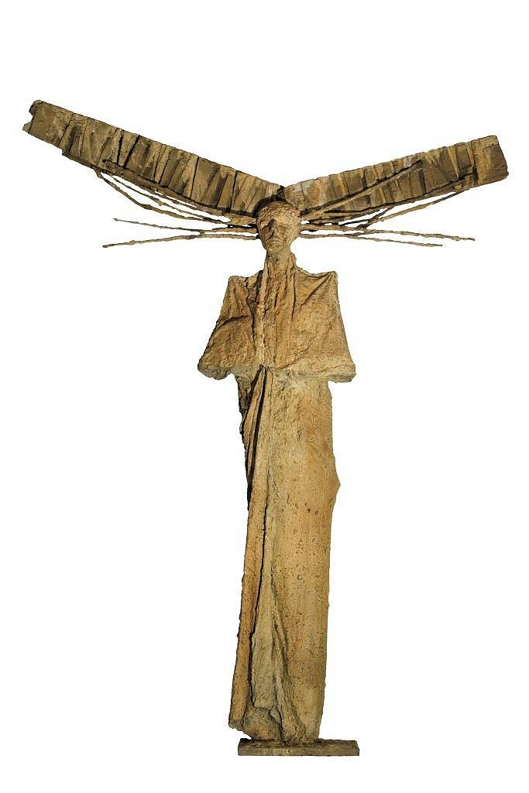
T
Appears to depict a person possibly Christ on the Cross
The crucifix emphasizes Jesus' sacrifice — his death by crucifixion, which Christians believe brought about the redemption of sins of mankind
The death and resurrection of the son of God is at the very heart of the Christian Faith.

Slide 8
O
Represents the human mind uniting mankind across the globe
Reaching out for world peace by holding hands together and encircling the earth together
Perhaps no signs of a specific religious sect reflected in the “O” except to show how we are all connected.

Slide 9
L
Represents a TREE
Trees in nature are often the origins of FAITH and SACRED meanings through the ages
Many cultures connect with their ancestors through trees. Ancestors are seen as the gods responsible for life, death and spiritual happiness
Trees symbolize growth, death and rebirth (through their foliage)

Slide 10
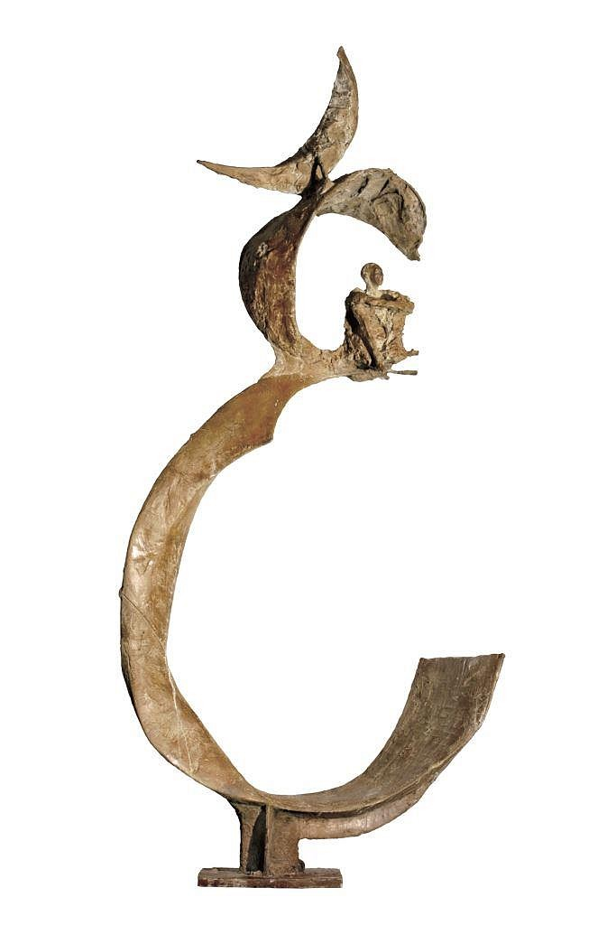
E
Represents Islamic faith
ALLAH is their God
Perhaps some representation of the “People of the Cave” - the story of a group of youths who hid inside a cave outside the city of Ephesus to escape a religious persecution
The moon is the brightest body in our night sly making our planet more livable and causes tides, creating a rhythm that has guided humans for thousands of years.

Slide 11
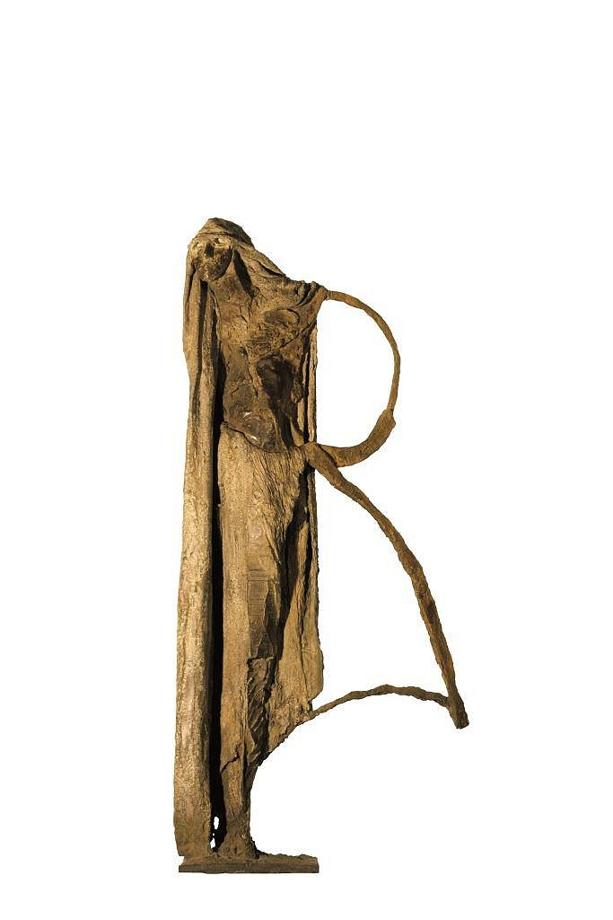
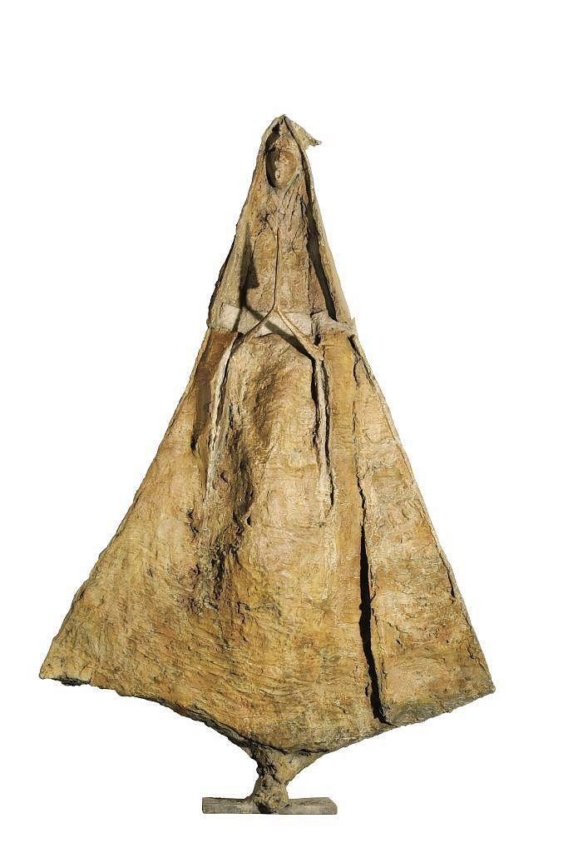
R
This could represent Hinduism with Shiva holding a staff
Hindus recognise three principal gods: Brahma, who creates the universe. Vishnu, who preserves the universe. Shiva, who destroys the universe at the end of each universal cycle which then allows for a new Creation. Shiva is the only God in the trinity who resides on Earth, abstaining from all forms of self-indulgence, concentrating rather on meditation as a means to find perfect happiness.

Slide 12
A
Could depict Christianity through the image of Mary
Mary, the mother of Jesus, commonly referred to as Mary, Mother of God, Saint Mary, Virgin Mary and Blessed Virgin Mary, is one of the most admired figures in Scripture and considered by many to be the greatest of all Christian saints.

Slide 13
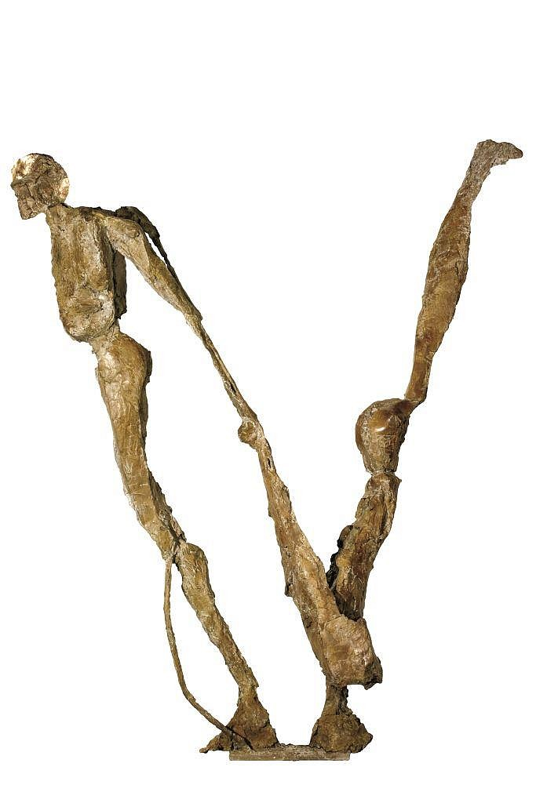
N
Judaism
The most important teaching of Judaism is that there is one eternal God, who wants all people to do what is just and merciful. All people are created in the image of God and deserve to be treated with dignity and respect.
In Jewish families, parents and children are responsible for each other as a way of honouring God.
A key principle of Judaism is to lift others up. The Hebrew word “Naso” means “to lift up” and with this word God commanded Moses and Aaron to “lift up” the Children of Israel. May the countenance of Adonai be lifted up before you, and give you shalom.” (Numbers 6:24-26)

Slide 14
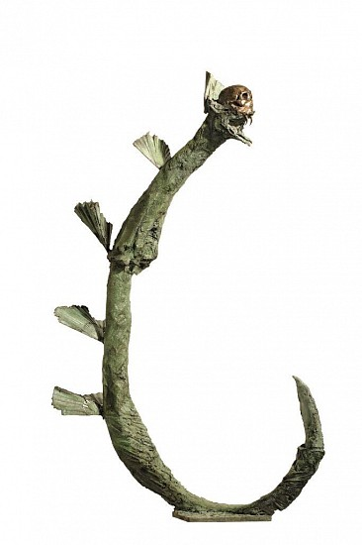
C
Confucianism is an ancient philosophy of respect and kindness
Rituals to honour ancestors are extremely important in Confucianism and many other religions and cultures.
Ancestral worshippers believe they can receive the aid and cooperation of deceased relatives. The living need to sustain their ancestors, as the ancestors are believed to influence the gods to bring them good fortune
The dragon is a symbol of power and strength for the people

Slide 15
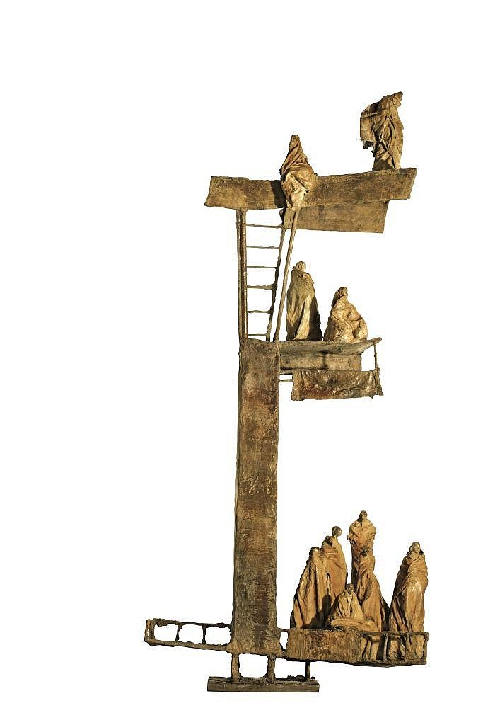
E
Ladders are important symbols of Buddhism
A path of enlightenment (like a ladder) to spiritual liberation
Suffering is inherent in life and one can be liberated from it by cultivating wisdom, virtue, and concentration.
Nirvana is a place of perfect peace and happiness. Nirvana is the highest state that someone can attain, meaning a person's individual desires and suffering go away.

Slide 16
“Willingness to accept behaviour and beliefs that are different from your own, although you might not agree with or approve of them”

