Slide 1


COVID-19 AWARENESS TRAINING & INDUCTION

Slide 2
Coronavirus Disease (COVID-19)
Human Coronaviruses are common throughout the world
The name Corona refers to a crown because these viruses have crown-like spikes on their surface when viewed under a microscope
COVID-19 is the scientific term used to describe the highly contagious virus that is spreading around the world
COVID-19 was discovered to be a completely novel strain; nothing experts had ever seen before
Coronavirus disease 2019 (COVID-19) is defined as illness caused by a novel coronavirus now called severe acute respiratory syndrome coronavirus 2 (SARS-CoV-2; formerly called 2019-nCoV), which was first identified amid an outbreak of respiratory illness cases in Wuhan City, Hubei Province, China
COVID-19 stands for Coronavirus Disease 2019. Coronavirus Disease 2019
Most often the disease is not serious but it can sometimes lead to severe illness and even death

Slide 3
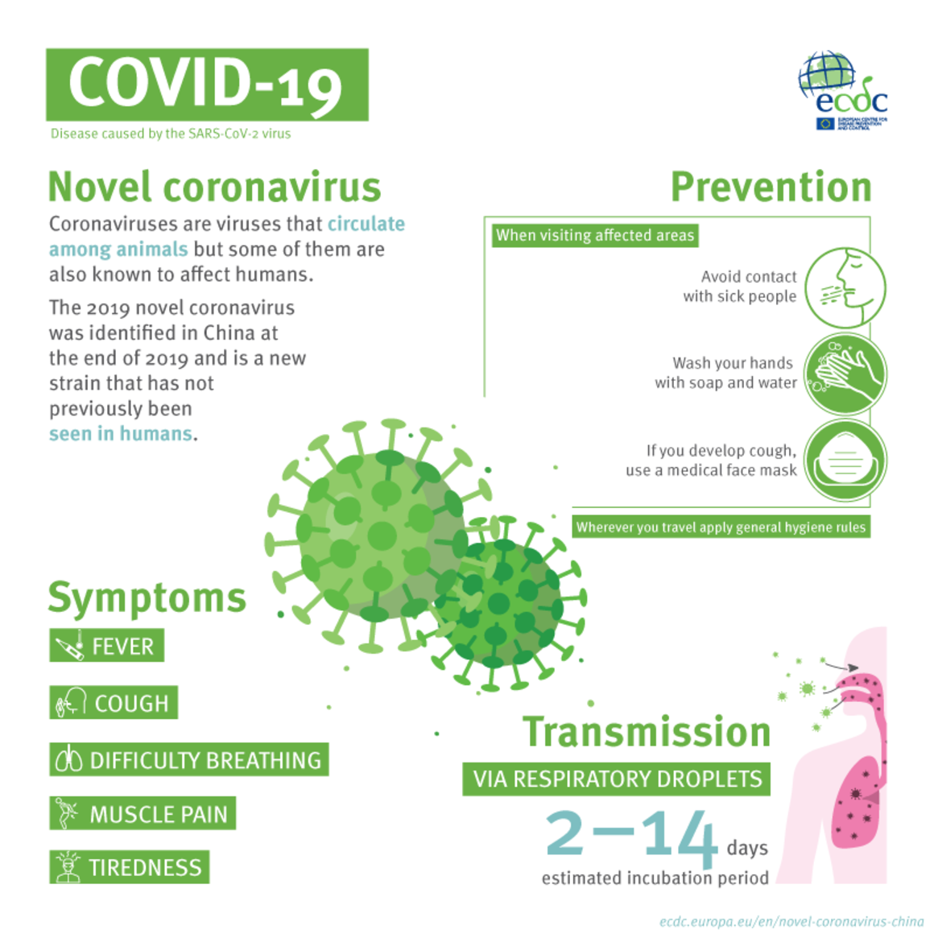

Slide 4
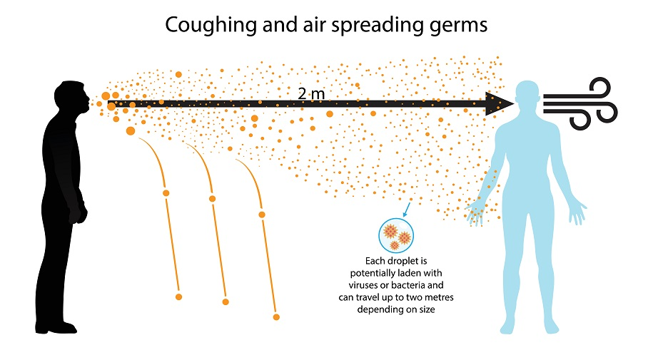

Slide 5
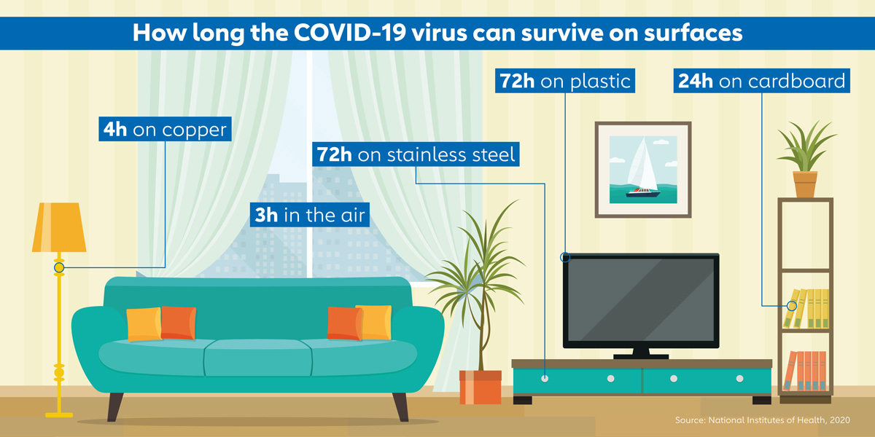

Slide 6
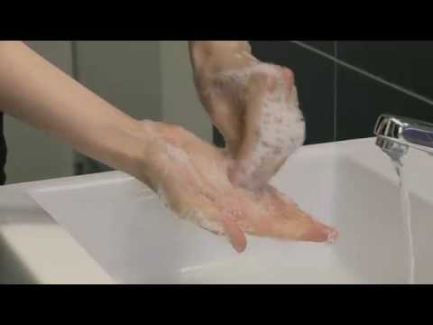
How to wash your hands Effectively

Slide 7
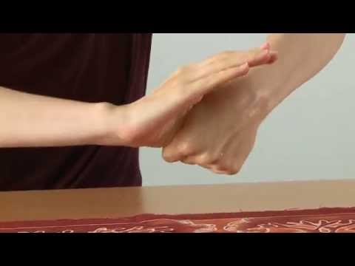
How to use Sanitiser Effectively

Slide 8
Who is at risk of contracting COVID-19
Employees in most workplaces are potentially at risk of contracting COVID-19 due to the fact that an infected employee may be working while not showing any symptoms.
Some workplaces have a higher risk of employees becoming infected due to the nature of work e.g. workplaces where close contact with other employees / clients is required.
Or in areas at work where multiple employees gather in small or confined spaces.
In order to mitigate this risk, various control measures have been implemented including the adoption of the following:
  COVID-19 Company Policy
  COVID-19 Workplace Risk Assessment
  COVID-19 Standard Operating Procedure
  COVID-19 Workplace Plan of Action
  Medical Screening Procedure
  Staff can access to these documents here and will acknowledge having read and understood them on the Induction Register filled in at the end of this slide show.
Ensure that you familiarise yourself with and abide by the company’s measures that are implemented to mitigate the risk of contracting COVID-19

Slide 9
Mitigation of risk in the workplace includes:
Primary prevention
  Education & training
  Policies and procedures
  Mitigation of risk through a detailed risk assessment
Secondary prevention
  Identify persons at risk and respond appropriately
  Conduct daily medical screening & surveillance
Tertiary preventioN
  Respond appropriately when there is a case of COVID-19 in the workplace
  Rehabilitation of workplace
  COIDA / Compensation claims
  Leave management

Slide 10
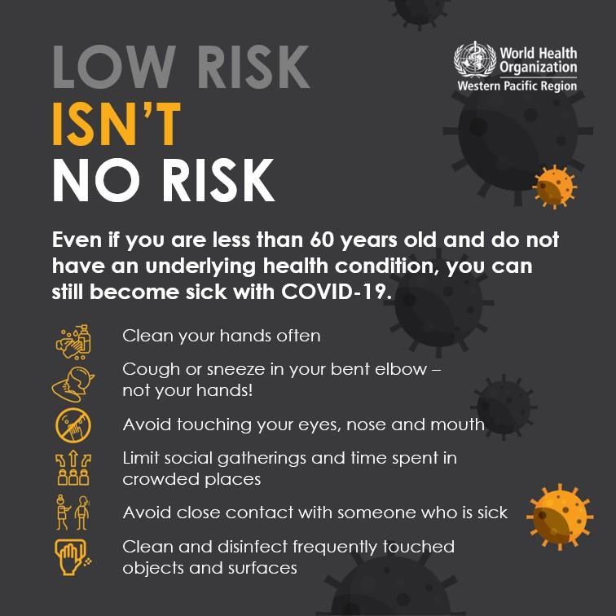

Slide 11
Personal Protective Equipment (PPE)
Management will issue each staff member with at least two cloth face masks – PPE Issue register MUST be filled in and signed.
Cloth face masks must be worn at all times, even while commuting to work and home if using public transport. If you are alone in your car no face-mask is required. It is however recommended that you sanitise your vehicle regularly.
PPE should not be used on its own and it is important that all other available control measures are implemented and adopted by ALL staff.
Select appropriate PPE in relation to the hazard
Ensure that it is properly fitted
Proper donning and doffing methods of PPE must be followed
Ensure that there is proper care, maintenance and disposal of the PPE (disposable masks, gloves, etc.)
Limitations of PPE include:
It does not eliminate the hazard
May restrict movement and be uncomfortable
Employees are often not correctly trained on its use
PPE on this campus includes:
Face shields
Face masks (face masks have now become compulsory for members of the public and staff members in South Africa)
Respiratory protection, when appropriate
PPE must be worn at all times as per the Company’s requirements – This is a requirement for all employees - NOT A CHOICE
Preventing the spread of COVID-19

Slide 12
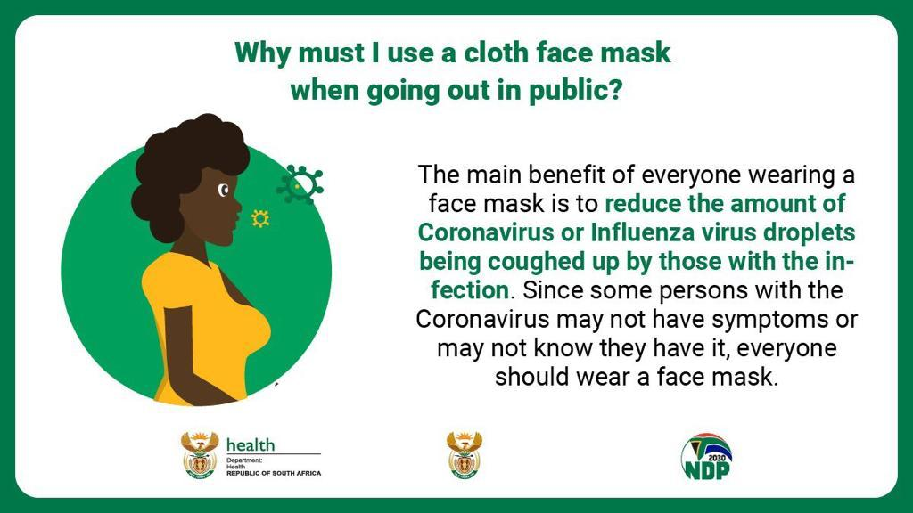

Slide 13


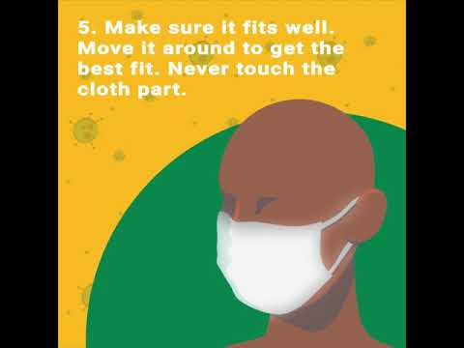



How to use a cloth face mask

Slide 14
Preventing the spread of COVID-19
Physical Distancing & Public Transport
Stagger arrival times of employees so that employees don’t congregate in reception areas especially due to medical screening requirements which may delay entry into the operations
Stagger tea-breaks
Have lunch at different times
Do not have lunch and tea in communal areas
When sharing an area with other employees ensure a 1.5 metre distance between them
Try and avoid using public transport when travelling to and from work if possible - if this is not possible, ensure physical distancing, good hygiene practices and always wear a cloth face mask
Place handbag in a plastic bag if possible when using public transport and dispose of the plastic bag immediately and sanitise your hands when arriving at work
If using public transport, the same procedure to be followed when returning home

Slide 15


Slide 16
Screening
Staff are to be screened for COVID-19 related symptoms and report such symptoms to the COVID-19 manager, their line manager / supervisor and the COVID-19 Compliance Officer immediately.
Employees to complete the screening questionnaire upon returning to work each day (example on the following slide).
Employees must be screened when they arrive at work - temperatures should be taken and it should be equal to or
below 37.5°C - temperature measurements should not be used in isolation of other screening mechanisms
Should an employee present any symptoms as per the employee self-declaration he/she should be isolated from all employees, issued with a FFP1 face mask and sent for COVID-19 testing at the COVID-19 Clinic (situated at house 32)
d) All staff are to report to their line manager and to the COVID-19 Compliance Officer / COVID-19 manager if:
  they are experiencing any symptoms
  they have been, or have potentially been, exposed to a person who has been diagnosed with COVID-19 or is suspected to have COVID-19 (even if the person who is suspected to have COVID-19 has not yet been tested), or
  they have undertaken, or are planning to undertake, any travel
  The full procedure can be found here: St Stithians Medical Screening Procedure
  Staff are encouraged to report if they observe another worker displaying any symptoms
Stop staff working if they are displaying symptoms
Stop staff who have contracted COVID-19 from returning to the workplace until they provide evidence they are clear of the virus

Slide 17
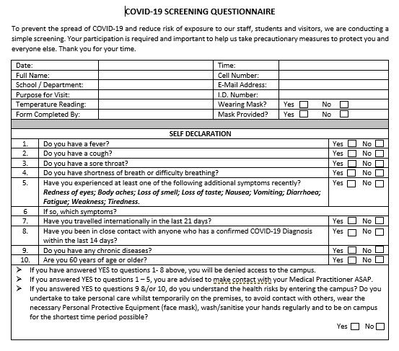

Slide 18
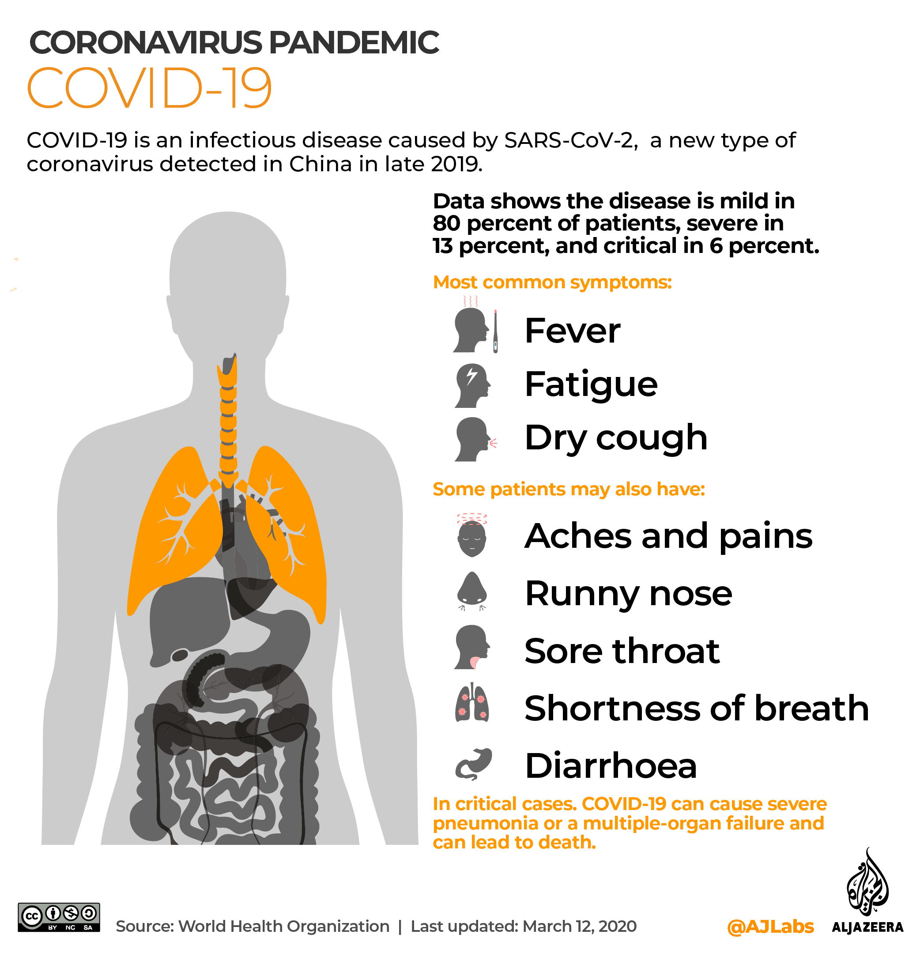
COVID-19 symptoms
Additional symptoms
Redness of eyes
Loss of smell
Loss of taste
Nausea
Vomiting
Fatigue
Weakness

Slide 19
Confirmed or suspected case in the workplace
Isolate the sick employee and issue them with a FFP1 mask.
Inform the national COVID-19 hotline (0800 029 999) and follow the advice of health officials.
Arrange for the worker to be transported in a manner that does not place other workers or members of the public at risk for a medical examination or testing.
Ensure the staff member is tested at a medical facility for COVID-19.
Inform the Department of Health and the Department of Employment and Labour if an employee tested positive.
Clean the area where the person was working and all places they have been. This may mean evacuating those areas.
Identify who at the workplace had close contact with the infected person. refer those workers who may be at risk for screening and take any other appropriate measure to prevent possible transmission; ensure that the worker is tested or referred to an identified testing site
Clean the area where the close contact people were working and all common areas they have been. This may mean evacuating those areas.
Review risk management controls
If the employee is not at work when he / she is diagnosed or suspected to have COVID-19, then follow steps 5, 6, 7 and 8, 9 above
The full incident reporting procedure can be found HERE And the coida reporting procedure can be found here

Slide 20
Close contact with confirmed case
Staff who have come into close contact with an individual who has tested positive for COVID-19 (co-worker or otherwise) will be directed to self-isolate for 14 days from the last date of close contact with that individual.
Close contact is defined as approximately one and a half meters.
If the College learns that a staff member has tested positive, the COVID-19 school-based response team will conduct an investigation to determine co-workers who may have had close contact with the confirmed positive staff member.
Those staff members who have had close contact will need to self-isolate for 14 days from the last date of close contact with that staff member.
If applicable, the COVID-19 response team will also notify any sub-contractors, vendors/suppliers or visitors who may have had close contact with the confirmed-positive staff member.
If a staff member learns that he or she has come into close contact with a confirmed-positive individual outside of the workplace, he/she must alert the COVID-19 Compliance Officer COVID-19 manager or line manager/ supervisor immediately, seek testing and self-isolate until his/her results have been received.

Slide 21
Communication
Response team and COVID-19 manager to update staff members on a regular basis on COVID-19 matters
Communication should be made by email, posters and notice boards.
Staff should be made aware if someone in the workplace has tested positive in order to create awareness.
Enhance internal reporting and communication channels.
Proactively review absenteeism of all staff. Those employees who do not report to work with a valid reason,
should be contacted and a COVID-19 symptom check should be done telephonically.
Note: Workers who are ill at home must stay at home – if they have COVID-19 symptoms they
must inform the COVID-19 Compliance Officer; COVID-19 manager or their line manager /
supervisor immediately

Slide 22
If it is confirmed that you have COVID-19
Stay home - People who are mildly ill with COVID-19 are able to recover at home. Do not leave, except to get medical care. Do not visit public areas.
Remain in contact with your doctor - Call before you get medical care. Be sure to get care if your health deteriorates or you think it is an emergency.
Avoid public transportation - Avoid using public transportation and stay away from others: Try and remain in a specific “sick room” and away from other people in your home. Use a separate bathroom, if possible.
Limit contact with pets & animals - Although there have not been reports of pets or other animals becoming sick with COVID-19, it is still recommended that people with the virus limit contact with animals until more information is known.
If you are sick - You must wear a facemask when you are around other people and before you enter a healthcare provider’s office.
Employee may only return to work once they have undergone a medical evaluation confirming that they have tested negative for COVID-19.

Slide 23
PLEASE NOTE THAT NO STAFF MEMBER WILL BE PERMITTED ON CAMPUS IF THEY HAVE NOT COMPLETED THIS INDUCTION. A REGISTER WILL BE POPULATED BY STAFF FILLING IN THE FORM
EXCEPTION WILL BE FOR THOSE STAFF WHO DO NOT HAVE INTERNET / WI-FI ACCESS FROM HOME – SPECIAL ARRANGEMENTS WILL BE MADE FOR THESE STAFF AS THEY ARRIVE ON CAMPUS – PLEASE INFORM YOUR HEAD IF YOU FALL INTO THIS CATEGORY SO THE NECESSARY ARRANGEMENTS CAN BE MADE
PROOF OF COMPLETION WILL BE PROVIDED BY FILLING IN THE FORM AND POST INDUCTION QUIZ HERE

Slide 24

THANK YOU
&
QUESTIONS
COVID-19 AWARENESS TRAINING & INDUCTION
Thank you for attending the COVID-19 Awareness and Induction session!
[COMPANY LOGO]

